Slide 1
Calculating Occupant Load: Gross v. Net Floor Areas
Presented by: Michael Fiebig, RA, AIA, NCARB, LEED GA, CFPS, CEP

Slide 2
Occupant Load
From the 2018 IBC:
Chapter 10: Means of Egress
Section 1004: Occupant Load
Scope:
This is how you calculate how many people your building can safely accommodate. Things like exit corridor widths, stair widths, exit door widths and counts, depend on the building’s occupant load.

Slide 3
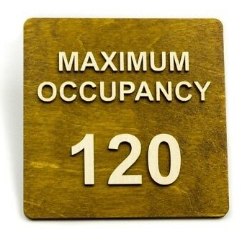
Occupant Load
In many public places, you’ll see signs like this one, identifying how many occupants the space can safely serve. Who determines this number? Generally, the architect as a part of the occupant load analysis.

Slide 4
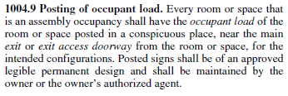
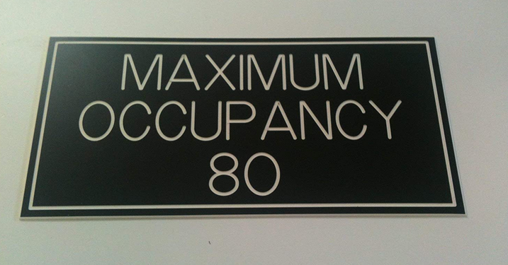
Occupant Load

Slide 5
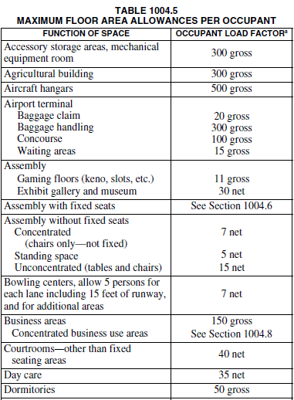
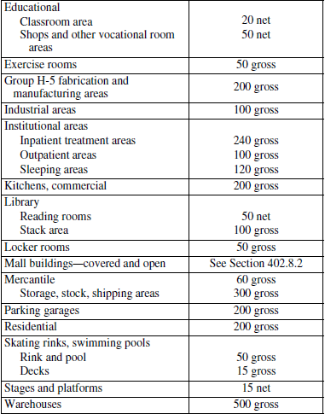
Occupant Load

Slide 6
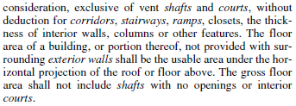
Occupant Load – Gross v. Net Floor Areas
Both Gross Floor Area and Net Floor Area are defined terms in the code:
Whether your floor area is to be calculated based on Gross or Net area is dependent on the use of the space.

Slide 7
Occupant Load – Gross Floor Area
Functions of spaces such as those at an airport terminal or a mercantile area (like a shopping mall) will be based on Gross Floor Area, because in such spaces it is more common for all usable spaces to be occupied at once (ex: in a shopping mall, the corridors, restrooms, stores, etc. can likely all be occupied simultaneously).

Slide 8
Occupant Load – Net Floor Area
Functions of spaces such as educational spaces, some assembly spaces, etc. will be based on Net Floor Area, because in such spaces it is generally expected that occupants will not as likely be in all occupiable spaces at once (ex: in a school building, a student will either be at his/her desk, in the corridor, or in the restroom, so these spaces will not be occupied simultaneously).

Slide 9
Thank you!
www.fiebigarch.com
info@fiebigarch.com

