Slide 1
Architectural Considerations for Solar Panel Retrofitting on Low-Slope Roof Systems
Presented by: Michael Fiebig, RA, AIA, NCARB, LEED GA, CFPS, CEP

Slide 2
Solar Panels on Low Slope Roofs
In retrofitting an existing low-slope roof for solar panel installation, there are several important factors to consider:
-Structural Load Capacity of the Roof
-Load Capacity of the Individual Components of the Roof Assembly
-Maintaining Performance Requirements of the Roof

Slide 3
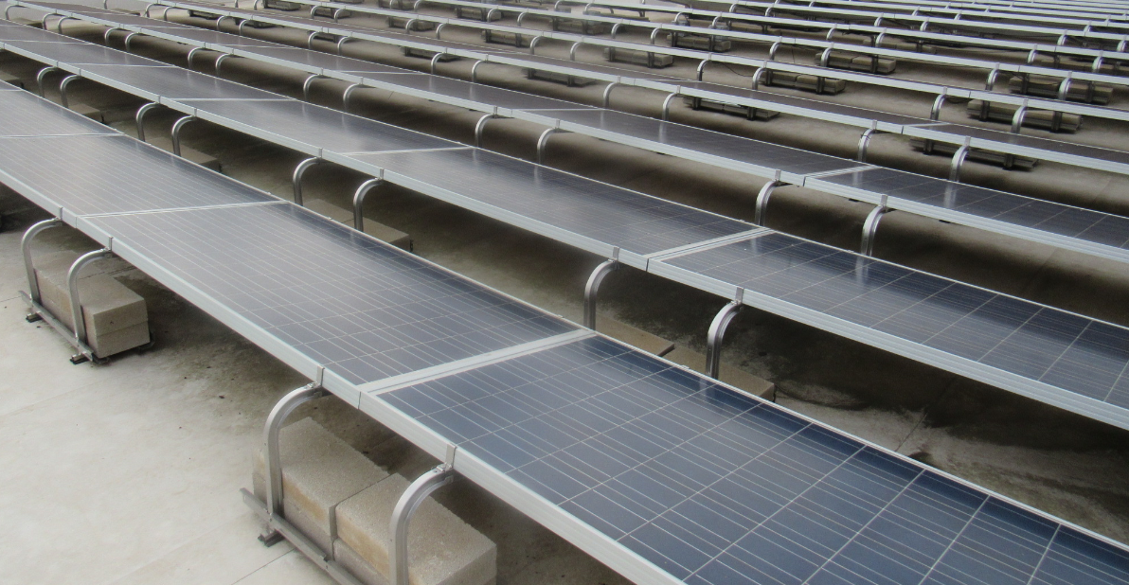
Structural Load Capacity of the Roof
Can the existing roof structure (structural deck, primary members, secondary members, etc.) handle the weight of the solar panels?

Slide 4
Load Capacity of the Individual Components of the Roof Assembly
The structure is not the only thing to consider when designing a new solar panel array on an existing roof. Also consider the effects of adding concentrated loads on the roof assembly components:
-Cover Board/Protection Board (Gypsum based? Cementitious based? Mineral fiber board? Others…)
-Rigid Insulation on Roof Deck (Consider the compressive strength values of the insulation)
-The Roof Membrane Itself (Can a concentrated point load damage the membrane?)

Slide 5
Load Capacity of the Individual Components of the Roof Assembly
AIA article on solar ready design for low-slope roofs:
https://www.aia.org/articles/6198582-solar-ready-design-for-low-slope-r
“Damage is another important consideration. While ballasted solar panel mounting systems can be cost effective, they can add significant weight to the roof and may also shift and flutter during high winds and seismic activity. This movement could lead to damage of the roof membrane that is “detrimental to satisfactory long-term roof system performance,'' according to the National Roofing Contractors Association (NRCA).”
“Include an adhered high-compressive-strength coverboard directly beneath the roof membrane to withstand increased foot traffic, enhance system durability, and extend the life expectancy of the roof.”
“For a ballasted system, use high-compressive-strength insulation, a minimum of two layers, staggered and offset. These systems also should include a protection or separation sheet adhered to the membrane.”

Slide 6
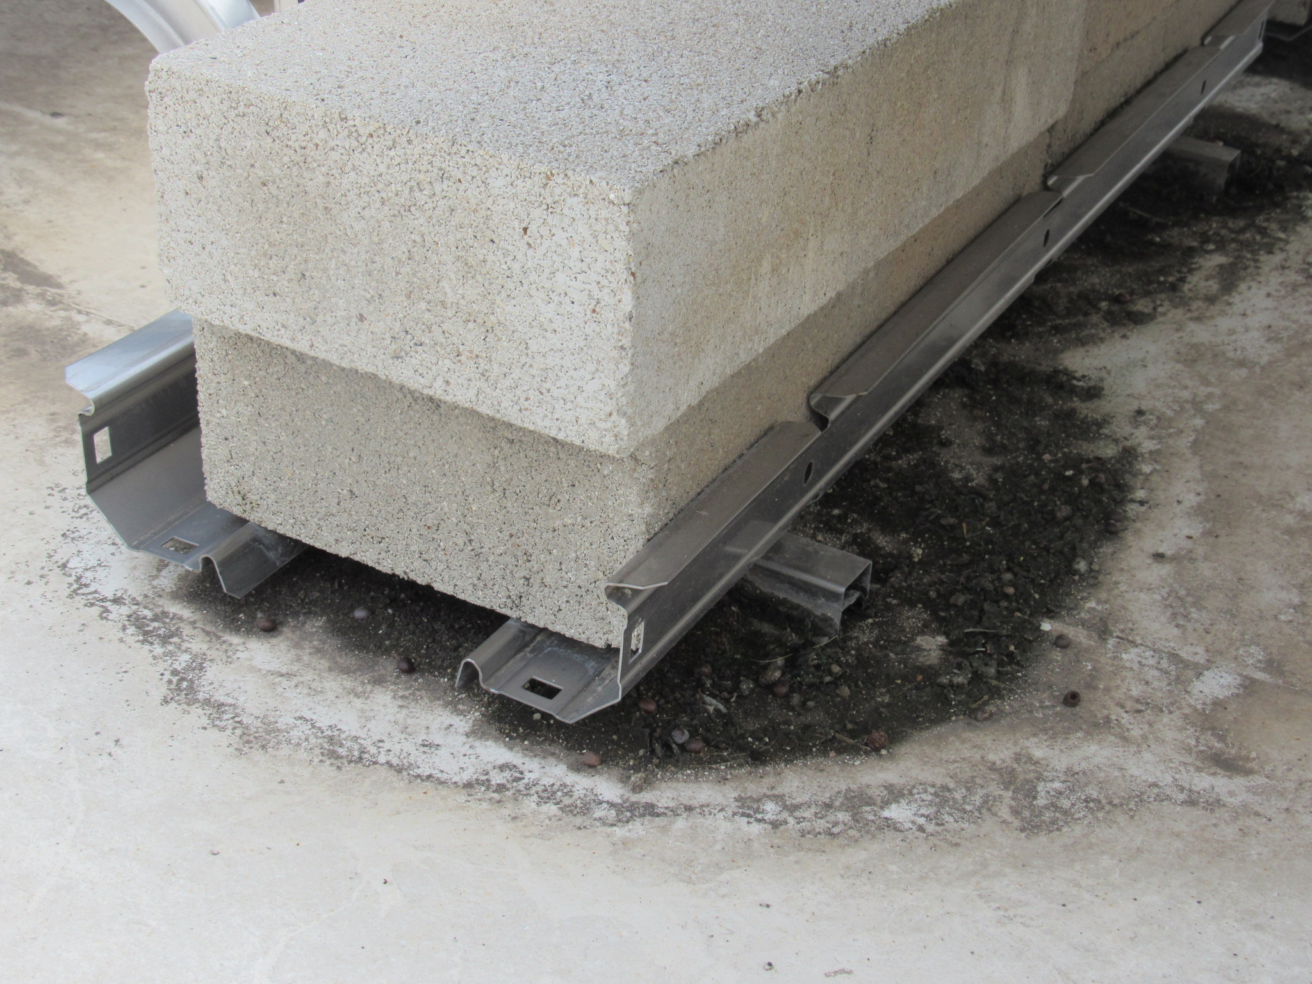
Load Capacity of the Individual Components of the Roof Assembly
The weight of the panels distributed through the point load of the bearing foot is compressing the underlying components and sinking into the roof.

Slide 7
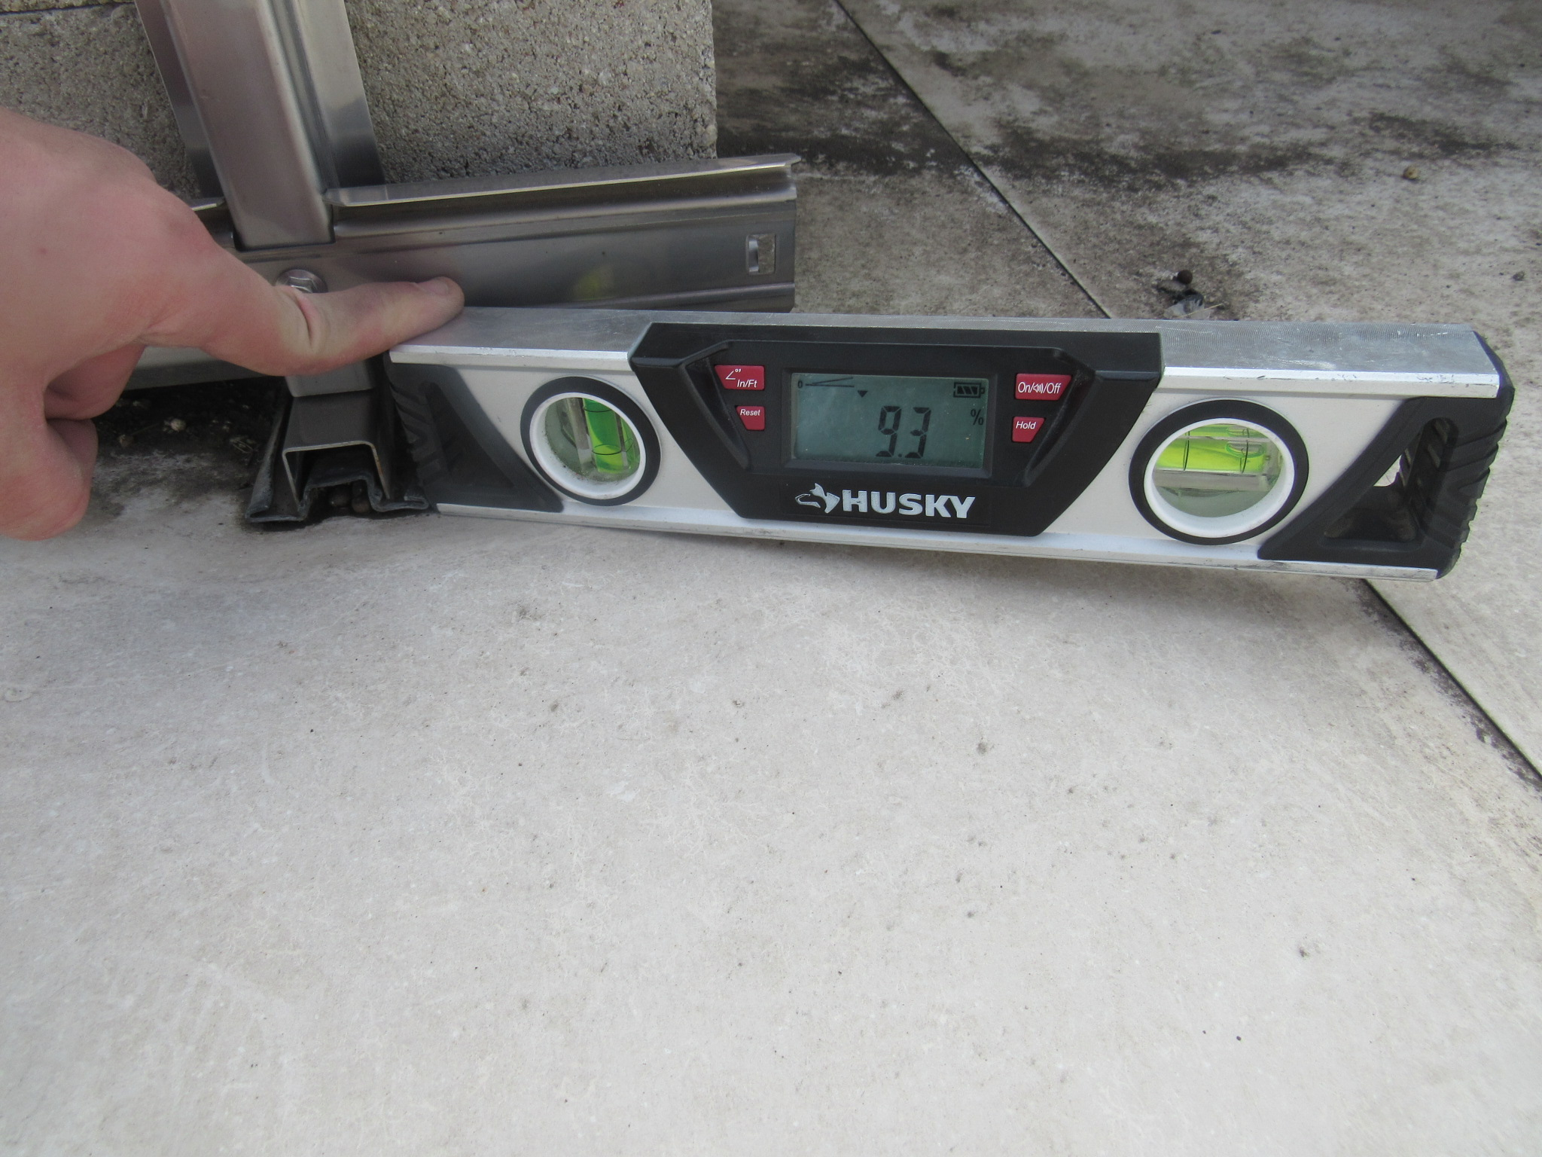
Load Capacity of the Individual Components of the Roof Assembly
The weight of the panels distributed through the point load of the bearing foot is compressing the underlying components and sinking into the roof.

Slide 8
Maintaining Performance Requirements of the Roof
Other requirements:
-Fall protection for maintenance personnel (roof guards needed?)
-Maintain the slope of the roof for drainage
-Maintain emergency personnel access (fire department access)

Slide 9
Fall Protection from Roof
International Code Council (ICC). “International Building Code,” 2012, Chapter 10, “Means of Egress,” Section 1013, “Guards,” Subsection 1013.6, “Mechanical Equipment,” states the following:
“Guards shall be provided where appliances, equipment, fans, roof hatch openings or other components that require service are located within 10 feet (3048 mm) of a roof edge or open side of a walking surface and such edge or open side is located more than 30 inches (762 mm) above the floor, roof or grade below.”
Solar panels are recommended to be cleaned every 6-months or so, and those personnel require fall protection if the solar panels are within 10-feet of the roof edge.

Slide 10
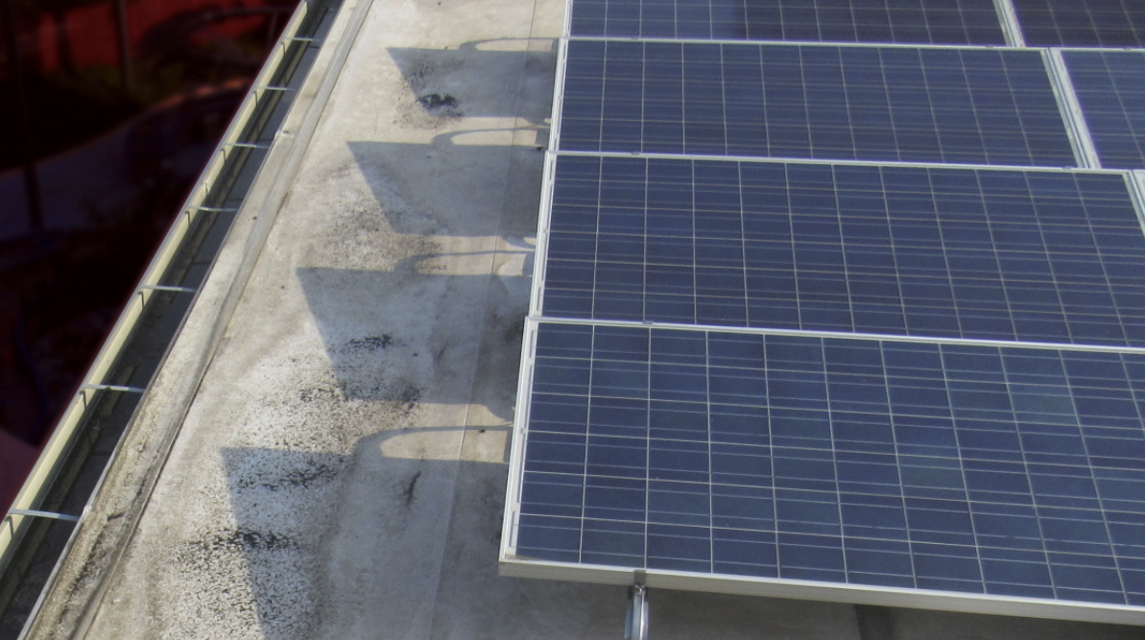
Fall Protection from Roof

Slide 11
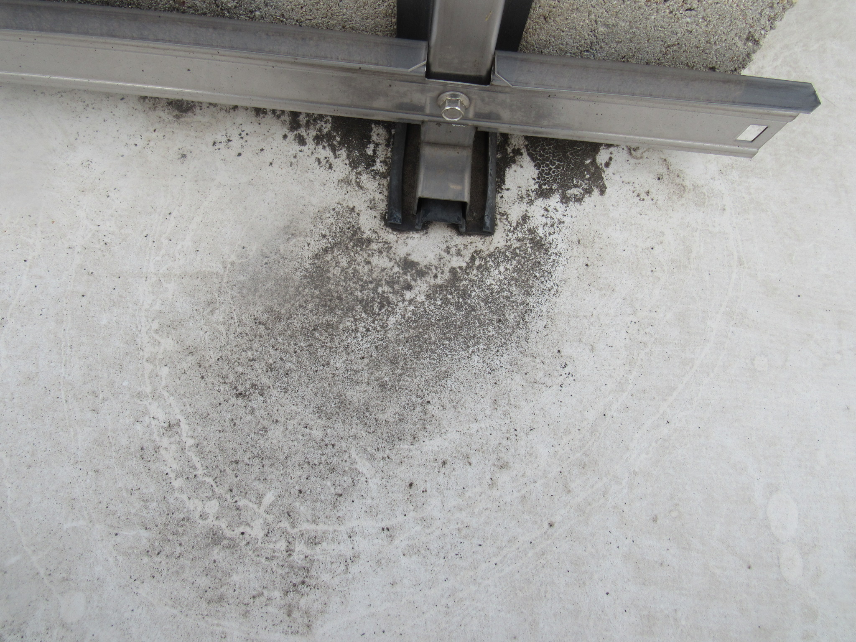
Roof Slope for Drainage
For low-slope roofs, code generally requires minimum slopes of ¼-inch per foot (0.25:12, or 2-percent). This can be achieved via sloped structure, or sloped insulation built-up on top of the roof deck. Ensure the weight of the new panels don’t compromise the drainage of the roof.

Slide 12
Emergency Personnel Access
International Code Council (ICC) “International Fire Code,” 2012, Chapter 6, “Building Services and Systems,” Section 605, “Electrical Equipment, Wiring and Hazards,” Subsection 605.11, “Solar Photovoltaic Power Systems,” Subsection 605.11.3, “Access and Pathways,” Subsection 605.11.3.3, “Other Than Residential Buildings,” Subsection 605.11.3.3.2, “Pathways,” Subsection 5, states the following:
“Shall provide not less than 4 feet (1290 mm) clear around roof access hatch with at least one not less than 4 feet (1290 mm) clear pathway to parapet or roof edge.”

Slide 13
Emergency Personnel Access
Maintain a 4-foot clearance between solar panels and parapet or roof edge:

Slide 14
Other Considerations
-Building Code Requirements (IBC, IRC, IFC, etc.)
-Product/Manufacturer Instructions
-Industry Standards (NRCA, etc.)
Consult with a licensed design professional to ensure all requirements are complied with.

Slide 15
Thank you!

